Slide 1



Slide 2
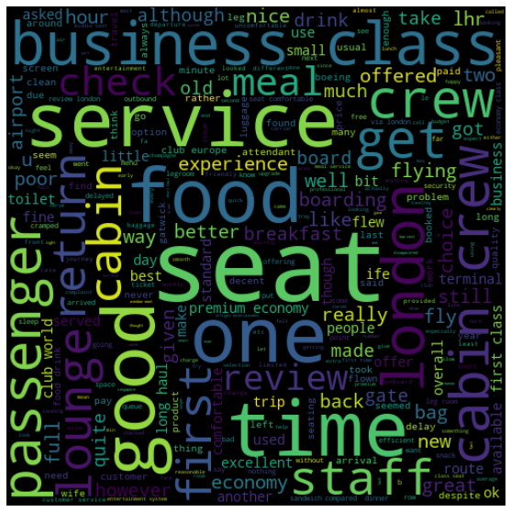
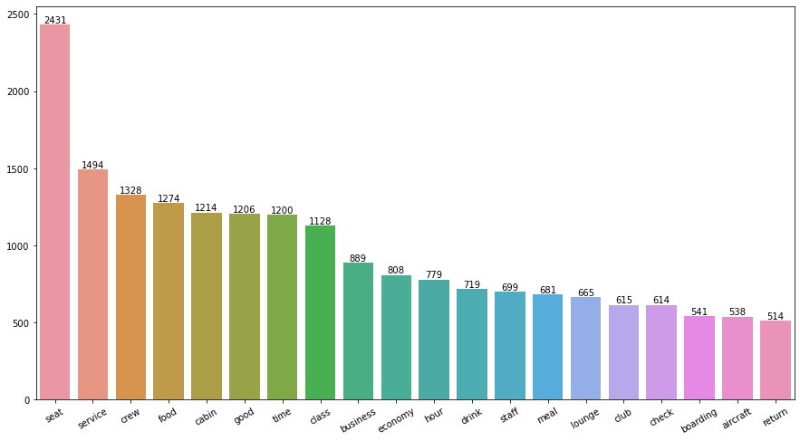
Based on the ratings data, customers who gave ratings between 7-10 were happy with comfortable seats, good inflight entertainment, and descent food quality. Customers who gave ratings between 4-6 faced issues with small entertainment screens, long passport check queues, and bad business class experiences. Customers who gave ratings between 1-3 were dissatisfied with congested middle seats and small screens, but they liked the seats and food. Overall, all customers appreciated the cabin crew service and staff, as well as the general economy seats. Many customers also traveled in business class and wanted value for their money.
Therefore, to improve the economy class experience, we should focus on enhancing inflight entertainment, improving seat comfort, and addressing issues related to delays. For business class customers, we should enhance the overall experience while keeping in mind their expectation for value for money. We should also improve the customer service on refund requests and streamline the process to ensure customer satisfaction.

